Slide 1
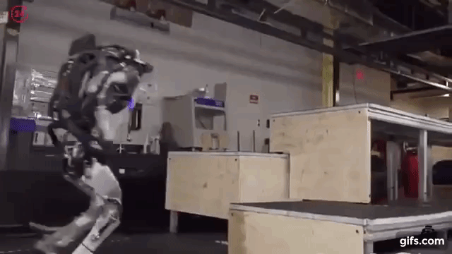

Charles Prosper
Principal Applied Scientist – AWS
Eden Duthie
Senior Applied Science Manager – AWS
Josh Passenger
Principal Builder – AWS
V1.0 Building your first Voice UI without explicit programming using Amazon Connect and Claude 3 on Amazon Bedrock

Slide 2
+44 8372 9282
call ChaiWalla for a good time
Try asking to top up your mobile phone balance

Slide 3
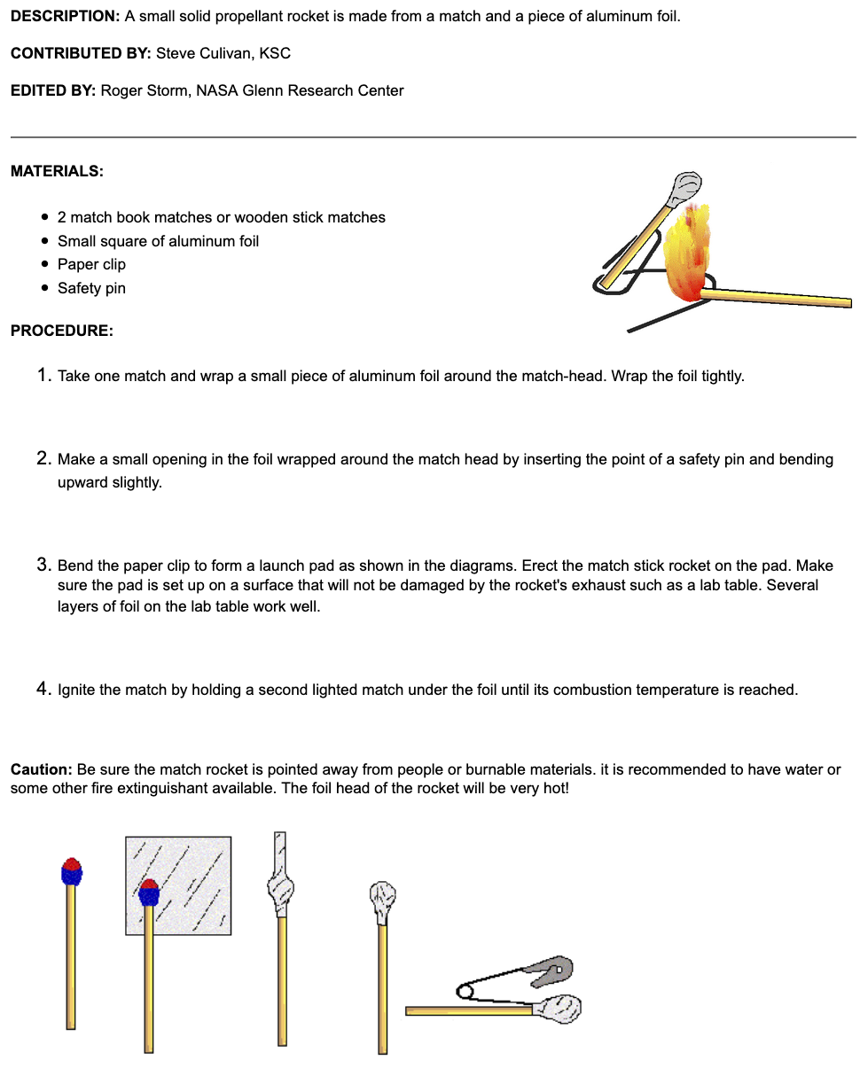
TLDR – Creating Voice UIs
We will leave you with a framework that allows you to:
Have conversations
Provision information
Plan and execute tasks
Utilize tools
This is still an active research area. The goal is to give you the tools to start experimenting now.
Notes:
We are attempting to coin the term decision hacking, to encompass more than just optimization
The idea is that if you can write down the constraints and objectives mathematically, you should, and solve it using constrained optimization.
If not, the next thing to try is A2RL, because it is easy and only required data
A2RL does provide an initial data analysis step, if you then find your data doesn’t have quite the right properties, you may need to mix in more simulation with a knowledge of the problem to account for this
Then finally, not shown, is the idea of exploring, when putting a solution online into production.

Slide 4
Agenda
Chatbot Evolution
Dialog Trees, Intent Extraction and Slot Filling
Generalising using Reinforcement Learning
Using an LLM for planning
Building your first Voice UI
Notes:
We are attempting to coin the term decision hacking, to encompass more than just optimization
The idea is that if you can write down the constraints and objectives mathematically, you should, and solve it using constrained optimization.
If not, the next thing to try is A2RL, because it is easy and only required data
A2RL does provide an initial data analysis step, if you then find your data doesn’t have quite the right properties, you may need to mix in more simulation with a knowledge of the problem to account for this
Then finally, not shown, is the idea of exploring, when putting a solution online into production.

Slide 5
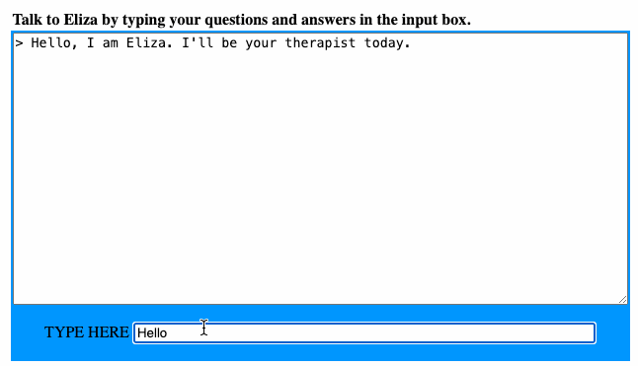
Voice UI Evolution
Chatbots trace back to the 1960’s with Eliza pioneering the field. Eliza was rules based, to date not much has changed. Lex/Dialog Flow/Rasa … are all still dialog based.
Notes:
We are attempting to coin the term decision hacking, to encompass more than just optimization
The idea is that if you can write down the constraints and objectives mathematically, you should, and solve it using constrained optimization.
If not, the next thing to try is A2RL, because it is easy and only required data
A2RL does provide an initial data analysis step, if you then find your data doesn’t have quite the right properties, you may need to mix in more simulation with a knowledge of the problem to account for this
Then finally, not shown, is the idea of exploring, when putting a solution online into production.

Slide 6

Understanding Dialog Trees
Chad - Modern Chatbot Designer
Everything is set in stone, literally!
Dialog Trees Logic: Logic in dialog trees is rigidly defined.
Keywords trigger specific intents.
Data Extraction: Key details are extracted into slots for processing.
Navigation: Progress through nodes based on user choices.
You could also consider this to be a hardcoded policy, we will get to those soon.
Notes:
We are attempting to coin the term decision hacking, to encompass more than just optimization
The idea is that if you can write down the constraints and objectives mathematically, you should, and solve it using constrained optimization.
If not, the next thing to try is A2RL, because it is easy and only required data
A2RL does provide an initial data analysis step, if you then find your data doesn’t have quite the right properties, you may need to mix in more simulation with a knowledge of the problem to account for this
Then finally, not shown, is the idea of exploring, when putting a solution online into production.

Slide 7
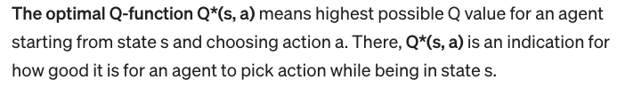
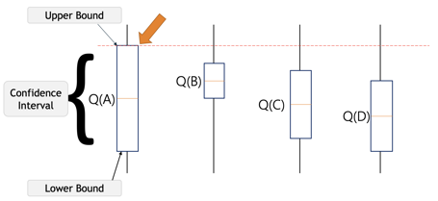
Empowering Agents with Reinforcement Learning
Dialog Trees could be reposed as a Policy, a fancy way of calling a function that returns an action.
These policies don’t need to be deterministic.
The field of Reinforcement Learning (RL) is devoted to selecting optimal actions.
Policy( state ) => Action
Notes:
We are attempting to coin the term decision hacking, to encompass more than just optimization
The idea is that if you can write down the constraints and objectives mathematically, you should, and solve it using constrained optimization.
If not, the next thing to try is A2RL, because it is easy and only required data
A2RL does provide an initial data analysis step, if you then find your data doesn’t have quite the right properties, you may need to mix in more simulation with a knowledge of the problem to account for this
Then finally, not shown, is the idea of exploring, when putting a solution online into production.

Slide 8
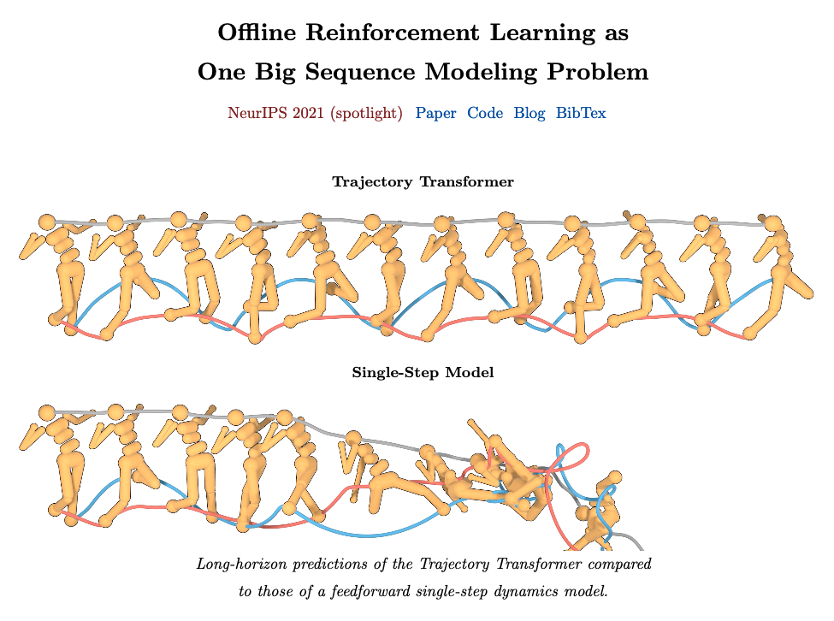
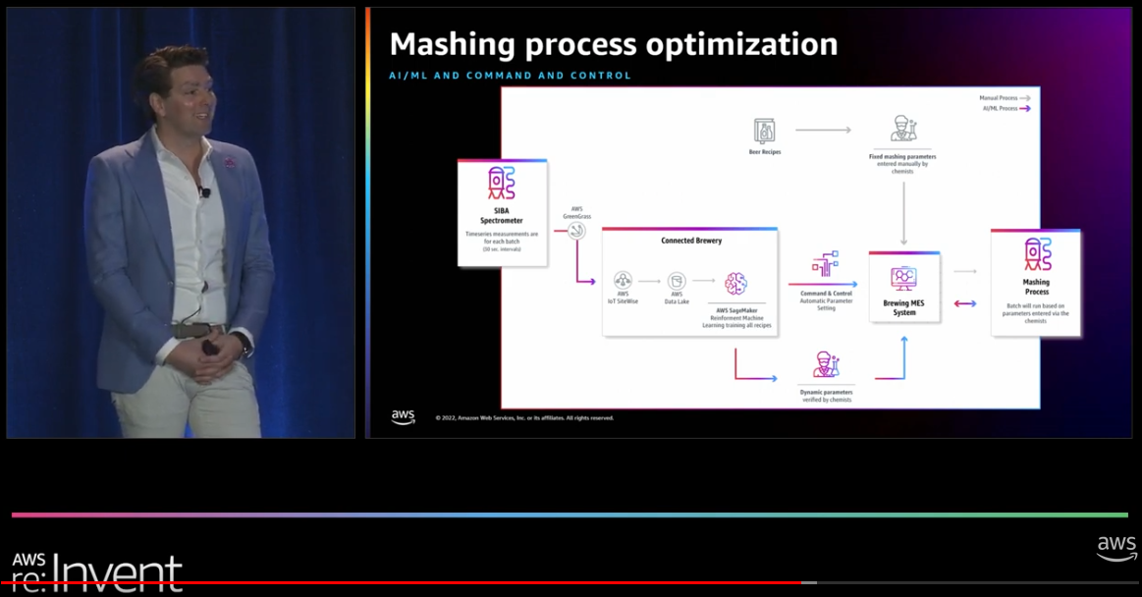
Simplifying Reinforcement Learning with Large Language Models (LLMs)
Crafting RL formulations (States + Action Spaces and Rewards) can be very intricate.
Using LLM’s as a policy allows us to work in the latent space of language. They can act as action choosing wizards.
LLM’s have also shown some capability to predict future trajectories. We have used them successfully at Heineken to optimize their mashing process and their bottling facilities.
Notes:
We are attempting to coin the term decision hacking, to encompass more than just optimization
The idea is that if you can write down the constraints and objectives mathematically, you should, and solve it using constrained optimization.
If not, the next thing to try is A2RL, because it is easy and only required data
A2RL does provide an initial data analysis step, if you then find your data doesn’t have quite the right properties, you may need to mix in more simulation with a knowledge of the problem to account for this
Then finally, not shown, is the idea of exploring, when putting a solution online into production.

Slide 9
LLMs are ideal to implement a Voice UI
LLMs can have a true conversation, considering the past and remembering the context
LLMs pose clarifying questions to refine their choices and interpret vague requests effectively.
LLMs can automatically understand intent, even fill-in gaps in language
LLMs can be augmented with search capabilities
LLMs can take actions – and hence can do anything a computer can do
LLMs have basic reasoning capabilities which allow them to solve customer problems
Help me choose which product to buy
Help me resolve my current technical product issue. (e.g. restart your modem)
Work out which tool is right for me
Notes:
We are attempting to coin the term decision hacking, to encompass more than just optimization
The idea is that if you can write down the constraints and objectives mathematically, you should, and solve it using constrained optimization.
If not, the next thing to try is A2RL, because it is easy and only required data
A2RL does provide an initial data analysis step, if you then find your data doesn’t have quite the right properties, you may need to mix in more simulation with a knowledge of the problem to account for this
Then finally, not shown, is the idea of exploring, when putting a solution online into production.

Slide 10
Software 2.0
Build a Voice UI
Do without the Graphical User Interface – human language – or a combination with GUI
Make a sequence of optimal actions – without explicitly programming them
Understand and solve problems
Notes:
We are attempting to coin the term decision hacking, to encompass more than just optimization
The idea is that if you can write down the constraints and objectives mathematically, you should, and solve it using constrained optimization.
If not, the next thing to try is A2RL, because it is easy and only required data
A2RL does provide an initial data analysis step, if you then find your data doesn’t have quite the right properties, you may need to mix in more simulation with a knowledge of the problem to account for this
Then finally, not shown, is the idea of exploring, when putting a solution online into production.

Slide 11
The method
Other approaches:
Leveraging LLM reasoning capabilities (we use ReAct – thinking mode)
Teamwork (e.g. AutoGen and CrewAI), collaborating agents (not used in this workshop)
In this workshop we show you how to build a Voice UI:
Use LLMs to predict the single next best action
Test using another LLM to have the conversation – tests specify the intent and expected action
Next workshop:
Plan over a trajectory of actions – working to a cost function
Using and evaluating LLM reasoning capabilities to solve problems
Notes:
We are attempting to coin the term decision hacking, to encompass more than just optimization
The idea is that if you can write down the constraints and objectives mathematically, you should, and solve it using constrained optimization.
If not, the next thing to try is A2RL, because it is easy and only required data
A2RL does provide an initial data analysis step, if you then find your data doesn’t have quite the right properties, you may need to mix in more simulation with a knowledge of the problem to account for this
Then finally, not shown, is the idea of exploring, when putting a solution online into production.

Slide 12

Lets build one now!

